Slide 1

COVID control policies to support students, teachers, staff, and families
Julia Raifman, ScD
Boston University School of Public Health
Julia Raifman, ScD
@juliaraifman
Jraifman@bu.edu
Notes:
Thank you everyone on the panel for inviting me to speak

Slide 2
Thank you for teaching, parenting, and supporting kids through a pandemic

Slide 3
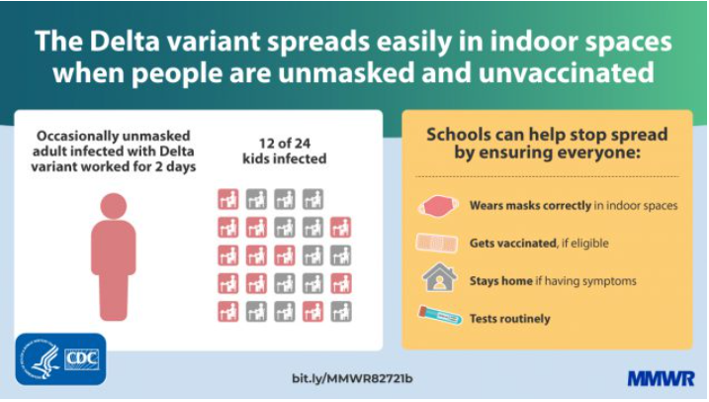
COVID spreads in crowded indoor settings, especially schools
Source: https://www.cdc.gov/mmwr/volumes/70/wr/mm7035e2.htm?s_cid=mm7035e2_w

Slide 4
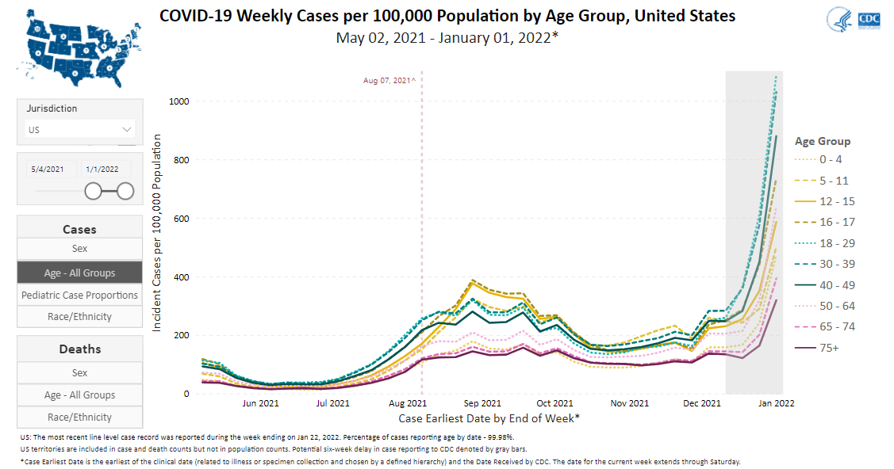
Children and parents had the most COVID cases in US in the fall
Children 12-17
Parent-age 30-49
Children 5-11
https://covid.cdc.gov/covid-data-tracker/#demographicsovertime

Slide 5
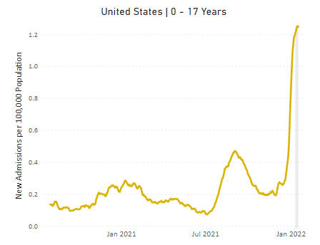
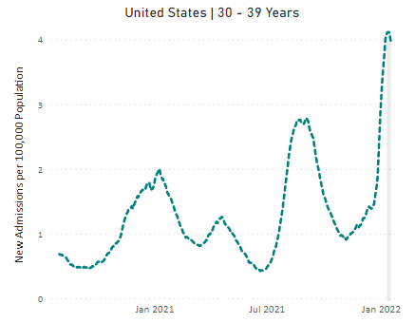
The virus drives a record number of child, parent, teacher, and staff-aged hospitalizations
https://covid.cdc.gov/covid-data-tracker/#new-hospital-admissions

Slide 6
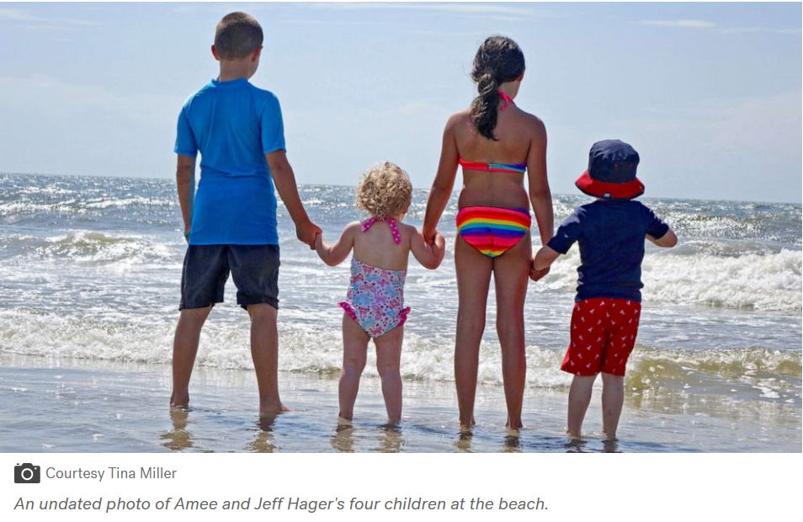
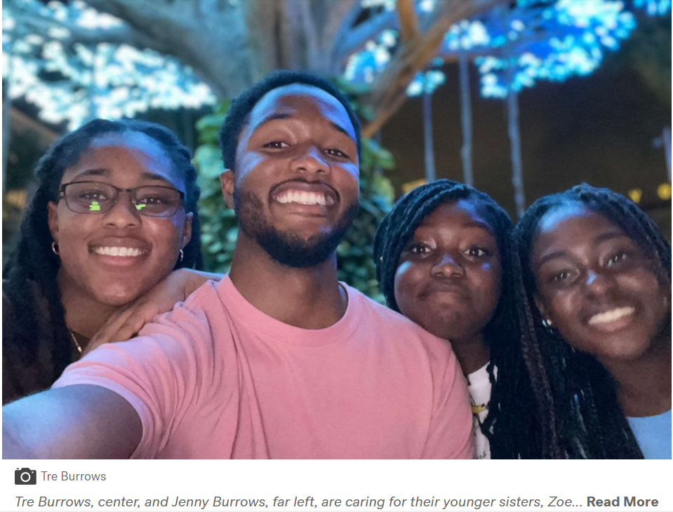
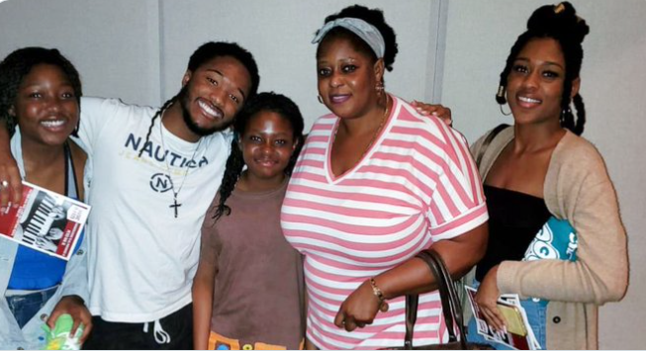
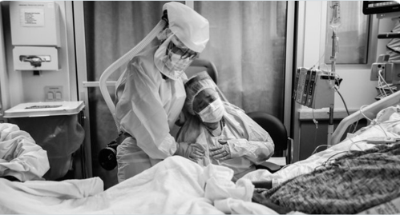

The virus caused 167,000 children to lose caregivers by December
Sources:
https://abcnews.go.com/GMA/News/kids-lost-parents-covid-19-describe-emptiness-feel/story?id=81448265
https://www.theledger.com/story/news/education/2021/10/11/16-polk-county-schools-employees-died-coronavirus-since-start-school/6090746001/
https://www.theatlantic.com/health/archive/2020/11/third-surge-breaking-healthcare-workers/617091/
Notes:
"We came back from break on Jan 3. During that week, two of my students contracted COVID-19 at school. They brought it to their separate homes and inadvertently infected their mom and grandma (who was the primary caregiver), both of whom died last week."

Slide 7
The virus causes harm through short- and long-term illness
People who miss work due to COVID in themselves or caregiving report food insufficiency
“We don’t know whether this is asthma brought out by COVID and it might go away in a year, or if it’s something else that might be lifelong”
- Carey Lumeng, MD, PhD
Unknown: Consequences and chances of long COVID with repeated infections
https://www.healthaffairs.org/do/10.1377/hblog20211021.197121/full/
https://www.aamc.org/news-insights/scary-and-confusing-when-kids-suffer-long-covid-19

Slide 8
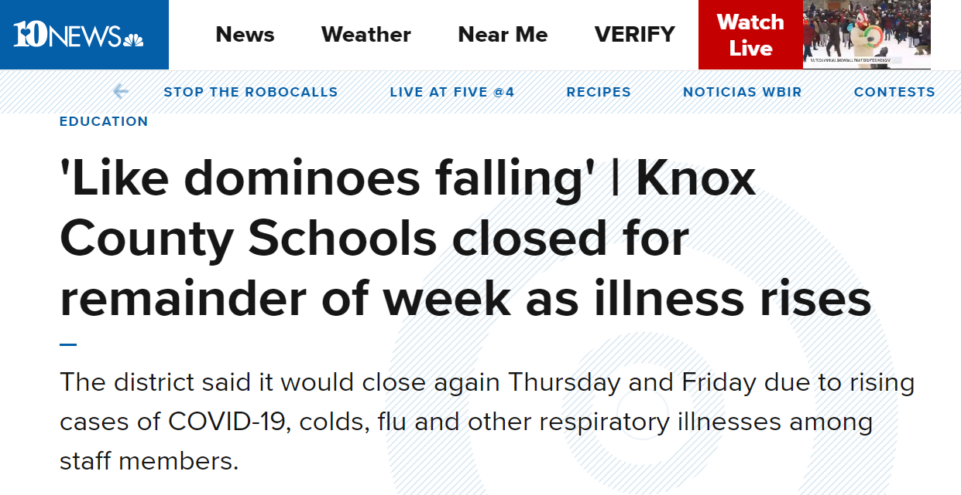
The virus is making teachers, staff, and students sick

Slide 9
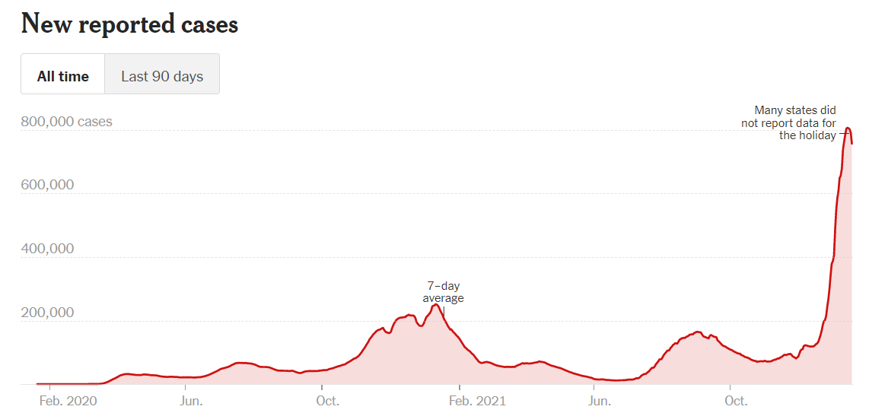
After 3 surges since this summer, there are likely to be more surges. They could be worse.
Omicron Wave 1: Deaths TBD
Delta Wave 1: ~160K dead
Delta Wave 2: ~70K dead

Slide 10
The virus is causing the harms:
Leaders can help us come together with good policies to manage the virus, so it does not manage us
Ground in facts: COVID spreads in all crowded indoor settings, including schools, and is harmful
Vaccines: Vaccine mandates
Masks: Data-driven mask policies and free N95s and KN95s
Ventilation: School safety standards
Tests: Free and supplied to schools

Slide 11
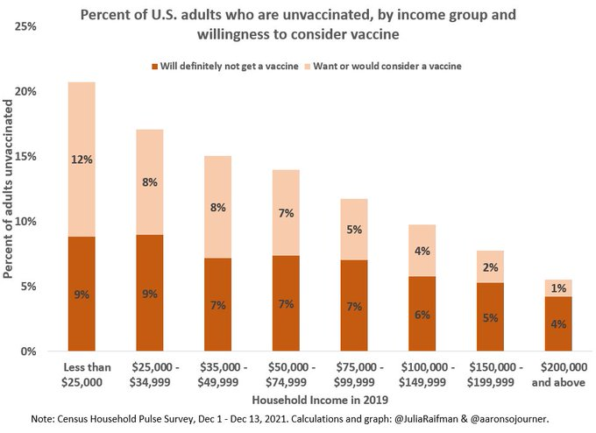
Vaccine mandates to improve coverage and reduce disparities

Slide 12
Masking alone: Less protection

Slide 13
Masking together: Most effective

Slide 14
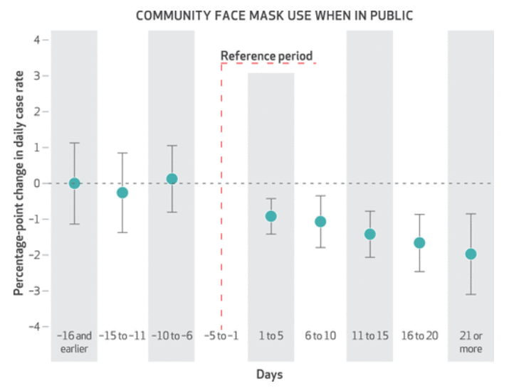
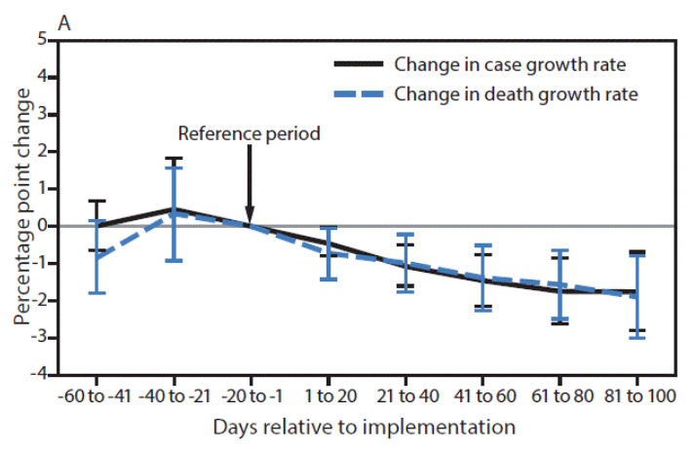
Strong evidence on state community face mask mandates & reduced COVID cases & deaths
Gery et al. CDC MMWR
State-issued mask mandates and county-level COVID-19 case and death growth rates, March 1–Dec 31, 2020
Lyu & Wehby, Health Affairs
State community face mask mandates and percentage point change in daily, county-level growth rate of COVID-19 cases, March 31 to May 22, 2020
Notes:
This study provides evidence from a natural experiment on the effects of state government mandates for face mask use in public issued by fifteen states plus Washington, D.C., between April 8 and May 15, 2020. The research design is an event study examining changes in the daily county-level COVID-19 growth rates between March 31 and May 22, 2020. Mandating face mask use in public is associated with a decline in the daily COVID-19 growth rate by 0.9, 1.1, 1.4, 1.7, and 2.0 percentage points.
comparing the pre-post mandate changes in COVID-19 spread in the states with mandates versus changes in COVID-19 spread in the states that did not pass these mandates, over time. The model also tested whether states issuing these mandates had differential pre-event trends in COVID-19 rates before they were issued. This is a critical assumption of the validity of an event study that must be upheld under testing. In addition, the model allowed us to control for a wide range of time-invariant differences between states and counties, such as population density and socioeconomic and demographic factors, plus time-variant differences between states and counties, such as other mitigation and social distancing policies, in addition to state-level COVID-19 testing rates. We estimated the effects of face cover mandates on the daily county-level COVID-19 growth rate, which is the difference in the natural log of cumulative COVID-19 cases on a given day minus the natural log of cumulative cases in the prior day, multiplied by 100.21 This measure gives the daily growth rate in percentage points.
the daily percentage point growth rate of county-level COVID-19 cases and county-level COVID-19 deaths. The daily growth rate was defined as the difference between the natural log of cumulative cases or deaths on a given day and the natural log of cumulative cases or deaths on the previous day, multiplied by 100. Weighted least-squares regression with county and day fixed effects was used to compare COVID-19 case and death growth rates before and after 1) implementing mask mandates and 2) allowing on-premises dining at restaurants. Because state-issued policies often applied to specific counties, particularly when states began allowing on-premises dining, all analyses were conducted at the county level. Four regression models were used to assess the association between each policy and each COVID-19 outcome. The regression models controlled for several covariates: restaurant closures in the mask mandate models and mask mandates in the restaurant reopening models, as well as bar closures,** stay-at-home orders,†† bans on gatherings of ≥10 persons,§§ daily COVID-19 tests per 100,000 persons, county, and time (day). P-values <0.05 were considered statistically significant. All analyses were weighted by county population with standard errors robust to heteroscedasticity and clustered by state. Mask mandates were associated with a 0.5 percentage point decrease (p = 0.02) in daily COVID-19 case growth rates 1–20 days after implementation and decreases of 1.1, 1.5, 1.7, and 1.8 percentage points 21–40, 41–60, 61–80, and 81–100 days, respectively, after implementation (p<0.01 for all) (Table 1) (Figure). Mask mandates were associated with a 0.7 percentage point decrease (p = 0.03) in daily COVID-19 death growth rates 1–20 days after implementation and decreases of 1.0, 1.4, 1.6, and 1.9 percentage points 21–40, 41–60, 61–80, and 81–100 days, respectively, after implementation (p<0.01 for all).

Slide 15
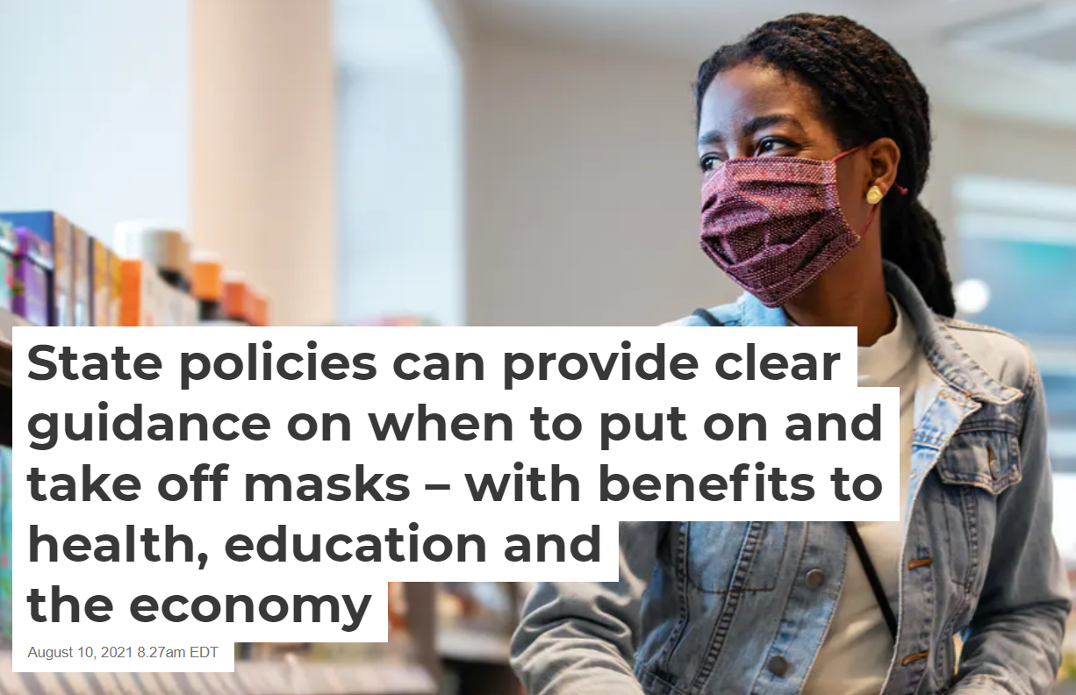
Data-driven mask policies: Mask when and where most important
Tinyurl.com/NVmasks

Slide 16
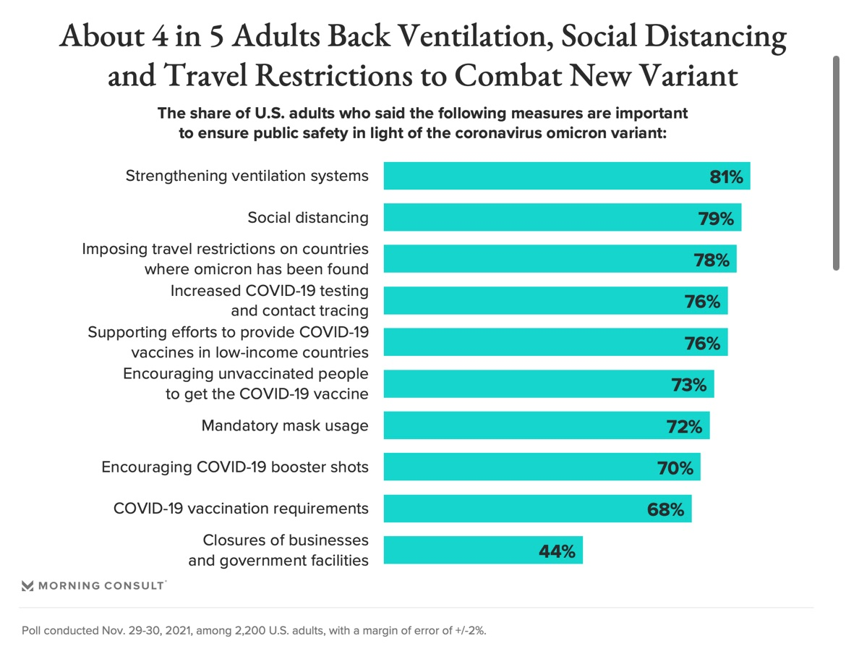
Most Americans want to come together with policies to manage the virus

Slide 17
Thank you

